Slide 1

IOT BASED SMART STICK FOR VISUALLY IMPAIRED PEOPLE
PANIMALAR ENGINEERING COLLEGE AN AUTONOMOUS INSTITUTION DEPARTMENT OF INFORMATION TECHNOLOGY
Project Members:
S.K.HARIVISHNU-211420205303
R.SHARATH BABU-211420205142
R.TAMIL SELVAN-211420205164

Slide 2
ABSTRACT :
To make the visually challenged people can be able to travel anywhere without anyone’s help.
It is an effective device for detecting the obstacles free paths in both indoor and outdoor settings.
It provides priority information about objects in the path.
Our prototype, helps people to find and recognize the objects.
The information deduced by the system is transmitted to the user by auditory communication method.

Slide 3
LITERATURE SURVEY:
TITLE | AUTHOR NAME AND YEAR | TECHNOLOGY | ADVANTAGES | DISADVANTAGES
Safe local navigation for visually impaired users with time of flight and haptic feedback device | R.K.Katzschmann, March 2018 | Haptic and Wearable computing Technology | It is wearable system that is capable of detecting scaffold obstacles. | Wearables are expensive. Some wearables devices are health risk.
A haptic solution to assist visually impaired in mobility tasks. | B.Ando, October 2015 | Range based Technology | It has a passive wheel at the bottom. The wheel is useful during its regular operation but it adds extra weight to the cane. | It cannot detect overhanging obstacles or sidewalk borders.
Co-robotic cane: A new robotic navigation aid for the visually impaired people. | C.Ye, S.Hong, April 2016 | Image Processing Technology | This system is useful in an indoor environment. It uses a 3D camera for object recognition. | It suffers from camera based system that are limited in the field of view.

Slide 4
TITLE | AUTHOR NAME AND YEAR | TECHNOLOGY | ADVANTAGES | DISADVANTAGES
Character recognition and its announcing using artificial intelligence. | Ramiro, March 2014 | Artificial Intelligence | It is computer based device that is useful for assessing assistive devices for blind people. | The system is able to simulate several eye disease conditions in human vision.
Arduino based smart walking stick for visually impaired to identify bus route. | S.Rangeetha, R.Sanjana, April 2016 | ZigBee Technology | ZigBee transmitter and receiver are used to transmit and receive signal over distance coverage of 100 meters. | It cannot be used as outdoor wireless communication system due to it has short coverage limited.

Slide 5
EXISTING SYSTEM:
Blind Cane:
1) Recognition of obstacles up to knee level.
2) Does not protect from obstacles at torso and face level.
3) Prone to injuries.
Trained Guide Dogs:
1) 1% usage.
2) Expensive to Train Dogs.
3) Training period on an average 6 months.
4) Difficulty in dog up-keeping costs and lifestyle changes.
Human Guide:
1) Dependency.
2) Feeling of being a burden.

Slide 6
DISADVANTAGES:
Only detect the obstacles and steps.
There is no alternate path.
GPS can’t attach in.
Little sensor support in these fields.
Limited and fixed route to follow daily routine.

Slide 7
PROPOSED SYSTEM:
Detect the object having a height below knee-level.
Two facilities:
1) Vibration
2) Audio message
Vibration strength and audio track depends on distance and position of the object.
Object Character Recognition(OCR).
Support Vector Machine(SVM).
Natural Language Processing(NLP) techniques.

Slide 8
ADVANTAGES:
It can be detect more distant obstacles.
It is easily to recognize the objects.
Simple to use and low cost.
Device can be converted easily.
Less accidents will be accrued from blind people.

Slide 9
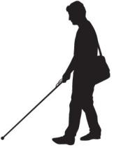

SYSTEM ARCHITECTURE:
ATMEGAa 328
Kit
Intimation Alert
Sense Obstacles
Audio Voice Signal

Slide 10
SYSTEM REQUIREMENTS AND SPECIFICATION:
HARDWARE REQUIREMENTS:
The hardware used for the development and installation of the project is:
Processor : Intel Dual Core
Hard Disk : 160 GB
RAM : 2 GB
IO Devices : Basic Keyboard and Mouse
Sound Output : Speakers

Slide 11
SOFTWARE REQUIREMENTS:
The software used for the development of the project is:
Operating System : WINDOWS XP / 7 / 8
Package : VISUAL STUDIO 2008 / 2010
Language : C#
Framework : .NET 3.5 / 4
Front End : C#.Net
Back End : Training Dataset

Slide 12
DEVICE INITIALIZATION MODULE:
The board is equipped with sets of digital and analog input/output (I/O) pins.
Using sensors to analyze the signals.
Micro controller and Micro processor
Arduino Board
Analog signals

Slide 13
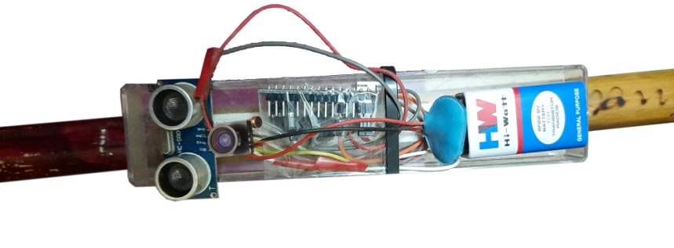
PROJECT MODEL:

Slide 14

FUTURE ENHANCEMENT:
Towards the future, this method can be extended by GPS via GSM module that will help to find the location and giving the voice-based directions.
ATMEGAa 328
Kit
Intimation Alert
Sense Obstacles
Image Acquisition
Image Processing
Text Identification
Audio Voice Signal
Text to Speech Synthesis
Natural Lang Processing

Slide 15
RESULT:
The system does not need the internet connectivity that is a basic necessity for other TTS system like a Google TTS in a Google keep.
In this project provides the audio alert to keep safe of the blind person from the hitting obstacles.
It is a low cost and high beneficiary system.

Slide 16
REFERENCES:
[1] Abdel Ilah Nour Alshbatat, “Automated Mobility And Orientation System For Blind Or Partially Sighted People", International Journal on Smart Sensing and Intelligent System.
[2] Alejandro R. Garcia Ramirez and Renato Fonseca Livramento da Silvaetal (2012)‟ Artificial EYE An Innovative Idea to Help the Blind”, Conference Proceeding of the International Journal of Engineering Development and Research(IJEDR), SRM University, Kattankulathur, pp.205-207, 2012.
[3] Chris Gearhart, Alex Herold, Dr. Brian Self, Dr. Charles Birdsong, Dr. Lynne Slivovsky, “Use Of Ultrasonic Sensors In The Development Of An Electronic Travel Aid”,IEEE Sensors Applications Symposium New Orleans, LA, USA - February 17-19, 2009.

Slide 17
[4] Jini.S, Swetha.P, Akshara.P.S, Jishnu S, Karthik Selvan, “Voice Maps for Visually Impaired with Obstacle Detection,” International Journal on Recent and Innovation Trends in Computing and Communication, Volume: 4 Issue: 3., pp.14-16, March 2016.
[5] Jismi Johnson, NikhalRajan P, Nivya M Thomas, Rakendh C S, Sijo T Varghese, “Smart Walking Stick for Blind”, International Journal of Engineering Science Invention Research & Development; Vol. III, Issue IX, pp. 557-560, March 2017.
[6] Johann Borenstein and Iwan Ulrich, “The Guide Cane- A Computerized Travel Aid for The Active Guidance Of Blind Pedestrians”, IEEE International Conference on Robotics and Automation, Albuquerque, NM, Apr. 21-27, 1997.

